Slide 1
SWAMI KESHVANAND INSTITUTE OF TECHNOLOGY,
MANAGEMENT and GRAMOTHAN
Presentation on
Feature-rich, advanced practical online website for the training and placement department of the college
SUBMITTED BY:
Komal Jha (19ESKIT300)
Anjali Arora (19ESKIT303)
Chestha Gautam(19ESKIT305)
PROJECT GUIDE : Mr. Praveen Kumar Yadav
SUBMITTED TO: Dr. Sanju Chaudhary
Date: 30 May 2023
Page No. 1
Session: 2022-2023

Slide 2
Table of Contents :-
Introduction
Technologies Used
IDE Used
Project Functions
Screenshots
References
Page No. 2
Date: 30 May 2023 Session : 2022-2023

Slide 3
Introduction
The project is aimed at developing an online web application for the training and placement.
The system is an online web application that can be accessed by the company and students with proper login provided.
The system provides a better way to maintain students information in the database, ensures data correctness and data integrity as well.
On Student side ,Firstly, on opening the web portal you’ll land on the main page of the portal which showcases information about the jobs.
Secondly ,there are four tabs given in the portal namely Internship, Applied, Bookmarks, Fulltimejobs. Each module has the same login page consisting of user id and password field for gaining access to the functionalities of the system.
Page No.
Date:
Session:
Page No. 3
Date: 30 May 2023
Session: 2022-2023

Slide 4
Technologies Used
React -
React components wrap existing native code and interact with native APIs via React’s declarative UI paradigm and JavaScript.
This enables native app development for whole new teams of developers, and can let existing native teams work much faster.React Native does not use HTML or CSS.
Instead, messages from the JavaScript thread are used to manipulate native view.
React Native also allows developers to write native code in languages such as Java for Android and Objective-C or Swift for iOS which make it even more flexible.
Page No. 4
Date: 14 Nov 2022
Session:2022-2023
Page No. 4
Date: 30 May 2023
Session: 2022-2023

Slide 5
HTML and CSS -
HTML is simply the only option with respect to the Frontend for the Web.
Abstractions like HAML, Jade, etc., are considered to be alternatives to HTML; however, even these abstractions are eventually converted
to HTML because that’s what the browser understands! So, if we are looking to wow the audience.
HTML along with CSS(Cascaded Style Sheets) makes a good case for itself. Think of CSS as a make-up artist and HTML as the actor, HTML brings the talent, but it looks plain without CSS.
.
Date: 30 May 2023
Page No. 5
Session: 2022-2023

Slide 6
JavaScript -
JavaScript is a lightweight, interpreted programming language.
It is designed for creating network-centric applications.
It is complementary to and integrated with Java. JavaScript is very easy to implement because it is integrated with HTML. It is open and cross-platform.
Javascript is the most popular programming language in the world and that makes it a programmer’s great choice.
Once you learnt Javascript, it helps you developing great front-end as well as back-end softwares using different Javascript based frameworks like jQuery, Node.JS etc.
Date: 30 May 2023
Page No. 6
Session: 2022-2023

Slide 7
NodeJS -
Node.js is an open source, cross-platform runtime environment for developing server-side and networking applications.
Node.js also provides a rich library of various JavaScript modules which simplifies the development of web applications using Node.js to a great extent.
A Node.js app runs in a single process, without creating a new thread for every request.
Node.js provides a set of asynchronous I/O primitives in its standard library that prevent JavaScript code from blocking and generally, libraries in Node.js are written using non-blocking paradigms, making blocking behavior the exception rather than the norm.
Date: 30 May 2023
Page No. 6
Session: 2022-2023

Slide 8
IDE Used
Visual Studio Code -
Visual Studio Code combines the simplicity of a source code editor with powerful developer tooling, like IntelliSense code completion and debugging.
First and foremost, it is an editor that gets out of your way. The delightfully frictionless edit-build-debug cycle means less time fiddling with your environment, and more time executing on your ideas.
Visual Studio Code is a free source-code editor made by Microsoft for Windows, Linux and macOS.
Features include support for debugging, syntax highlighting, intelligent code completion, snippets, code refactoring, and embedded Git.
Date: 30 May 2023
Page No. 7
Session: 2022-2023

Slide 9
Project Functions -
This project aims to develop an online automation system that is beneficial for SIM students and companies recruiting SIM graduates.
This software has two login portals, one for students and the other for recruiting companies.
Students will enter all their personal as well as professional while registering themselves into the system.
The students can also control the privacy settings of their accounts.
The companies register with their company name, Job title, No. of vacancy, Job description, Job profile, Criteria, etc. The students can view and apply to the companies.
The students can apply if job ads match with their interests and abilities, provided that they choose to make their information public.
Date: 30 May 2023
Page No. 8
Session: 2022-2023

Slide 10
Project Functions -
The companies can view the list of student profile who have applied to the particular company.
The company recruiter of the system, has the access to all the portal.The company recruiter can add, delete or edit information when need be.
The company recruiter can edit information according to their needs.
Student can also submit their CV.
Company can download the student's CV as per their interest.
All these functionalities are working fine and are user friendly
Date: 30 May 2023
Page No. 8
Session: 2022-2023

Slide 11

ScreenShots –
Login/Register Page
Date: 30 May 2023
Page No. 9
Session: 2022-2023

Slide 12
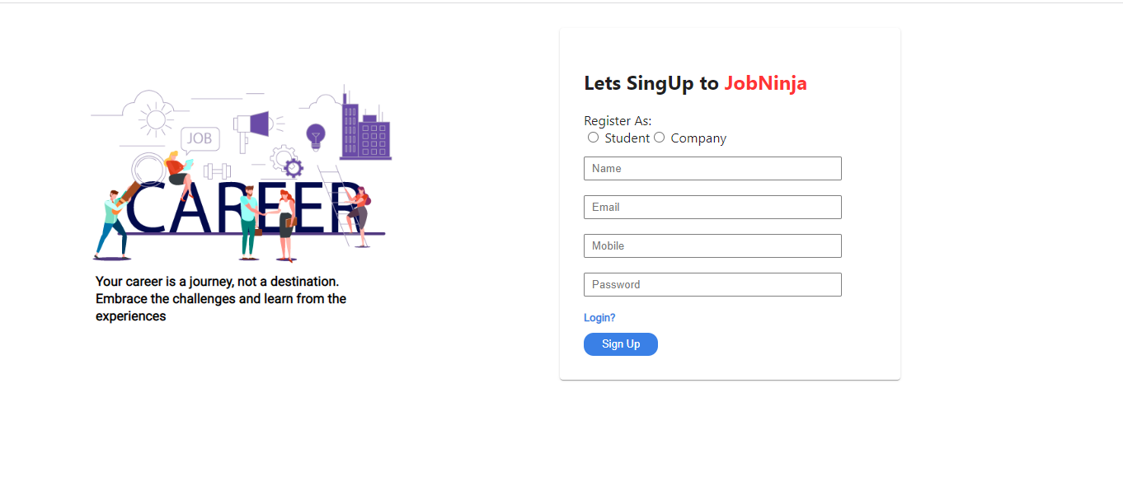
Registration Page
Date: 30 May 2023
Page No. 10
Session: 2022-2023

Slide 13

Companies Login Page
Date: 30 May 2023
Page No. 11
Session: 2022-2023

Slide 14
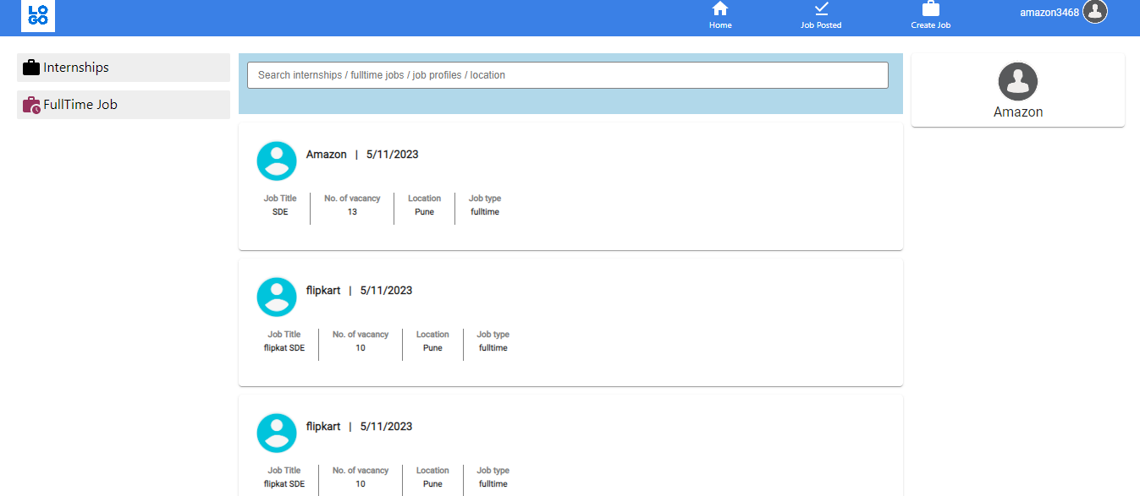
Date: 30 May 2023
Page No. 12
Session: 2022-2023

Slide 15
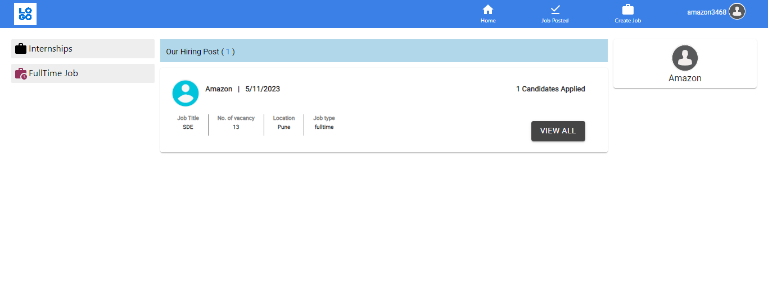
Date: 30 May 2023
Page No. 13
Session: 2022-2023

Slide 16
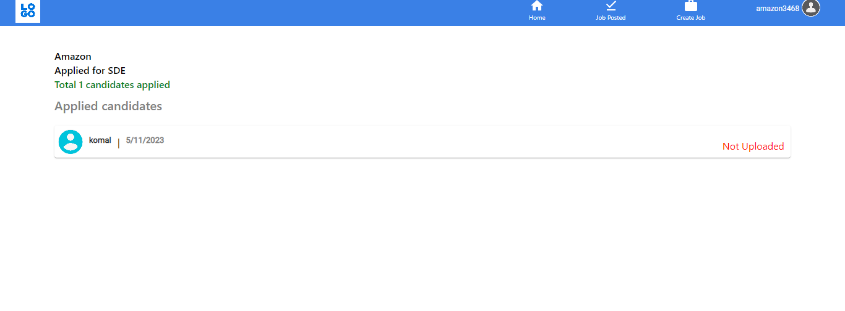
Date: 30 May 2023
Page No. 13
Session: 2022-2023

Slide 17
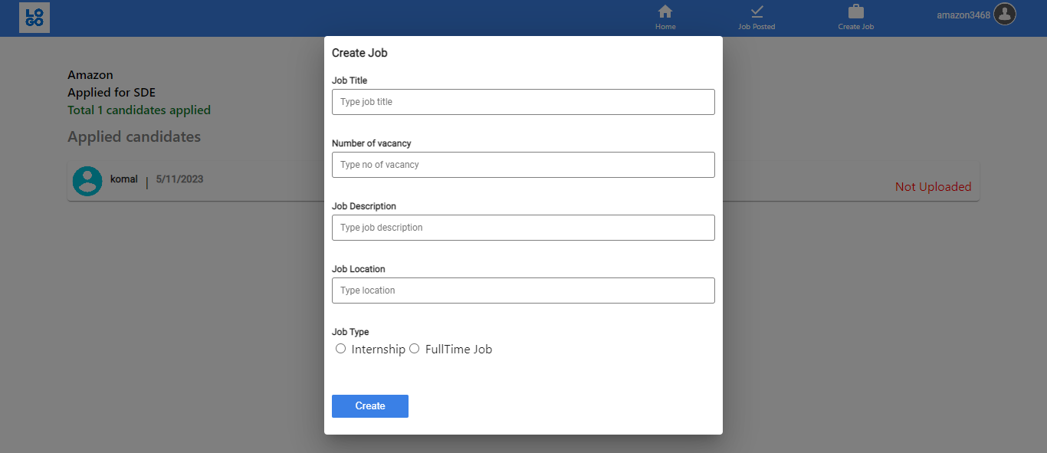
Date: 30 May 2023
Page No. 13
Session: 2022-2023

Slide 18
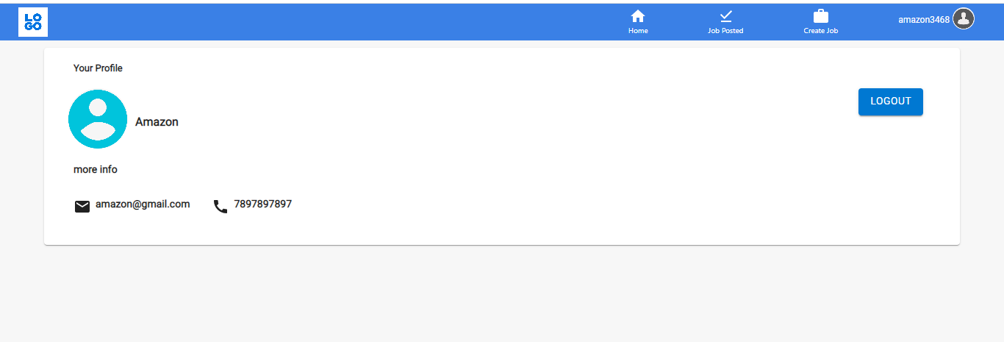
Date: 30 May 2023
Page No. 13
Session: 2022-2023

Slide 19
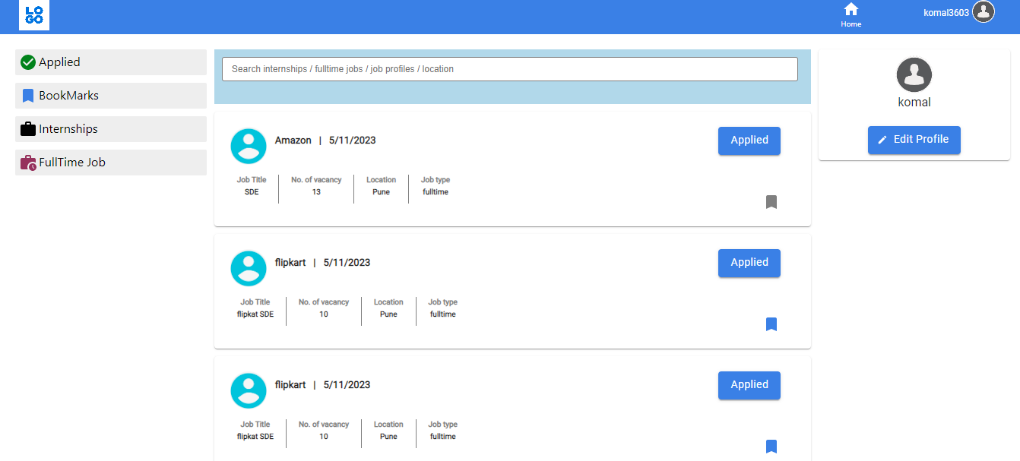
Student Home Page
Date: 30 May 2023
Page No. 13
Session: 2022-2023

Slide 20
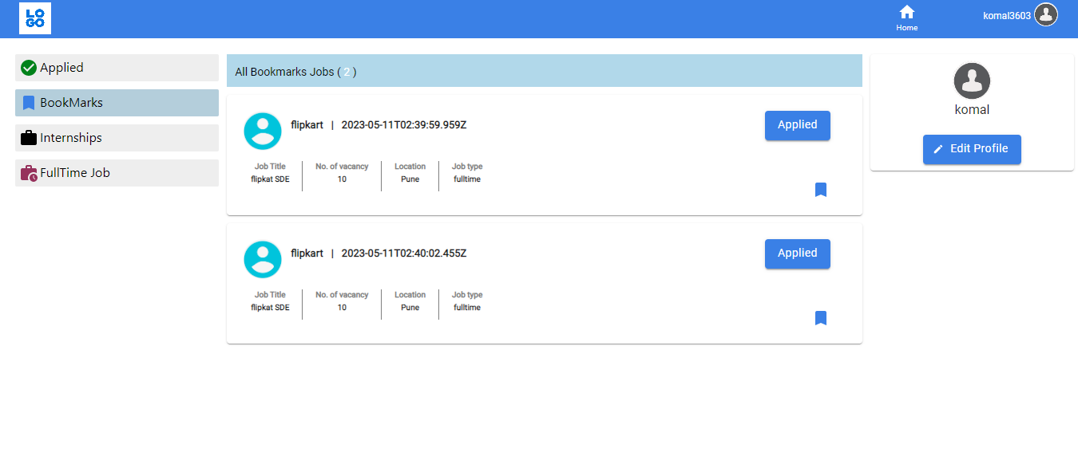
Date: 30 May 2023
Page No. 13
Session: 2022-2023

Slide 21
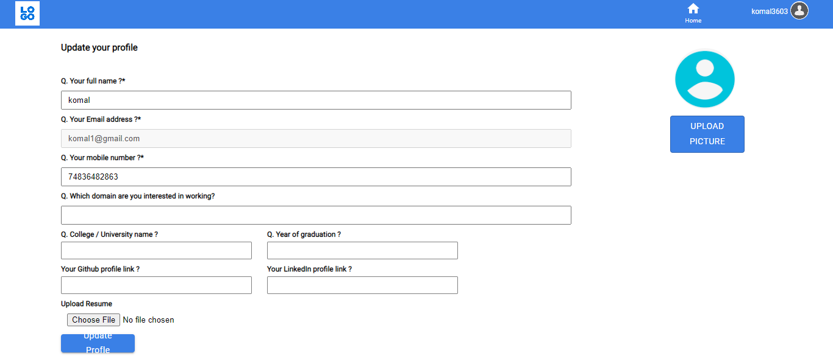
Date: 30 May 2023
Page No. 13
Session: 2022-2023

Slide 22
References :-
https://w3layouts.com/tag/training-placement-cell/
https://themeforest.net/item/campus-recruitment-system/20856917
https://www.nitt.edu/home/academics/placement/
https://www.researchgate.net/
Date: 30 May 2023
Page No. 14
Session: 2022-2023

Slide 23
Thank you!!
Date: 30 May 2023
Page No. 15
Session: 2022-2023

